Slide 1
Module Group Project - IMDCGD111
Module Managing Games Production - IMDCGD214
L4/5 Group 7
Oliver Chamberlain
Thomas Simmons Amy Potter
George Hutchings

Slide 2
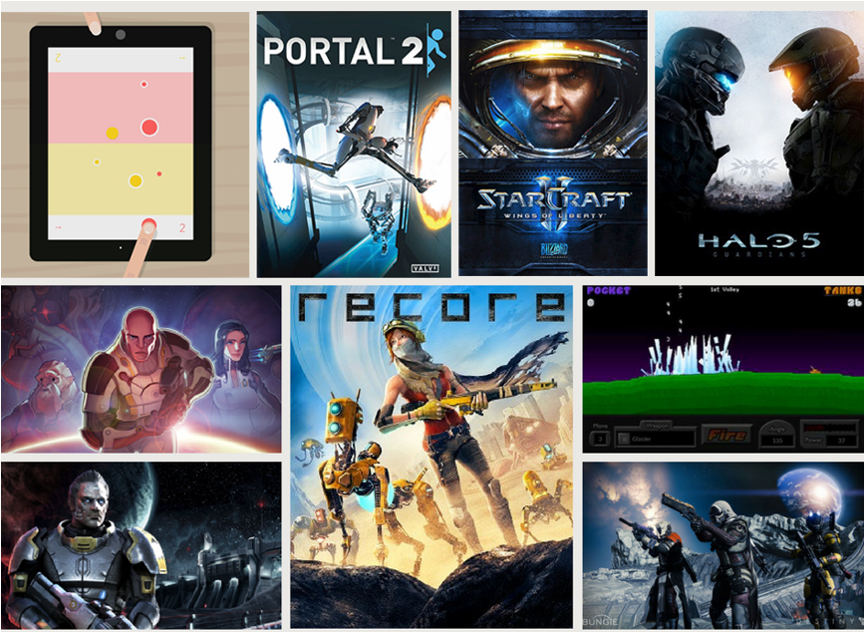
Demographic
Teenaged males - Aged between 13 and 17
Notes:
Boys are more attracted to games with violence whereas girls are more attracted to nurturing or methodical games
59% of gamers are male
Of all “super genres” action and shooters were the top two sold in 2014-15

Slide 3
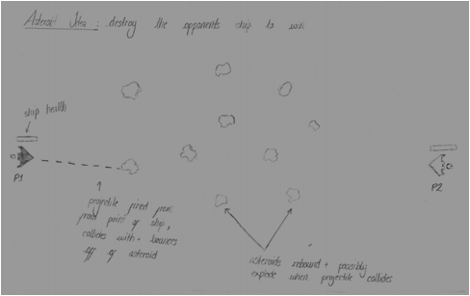
Unique Selling Point
Players must use the environment to injure each other instead of using their own weapons

Slide 4
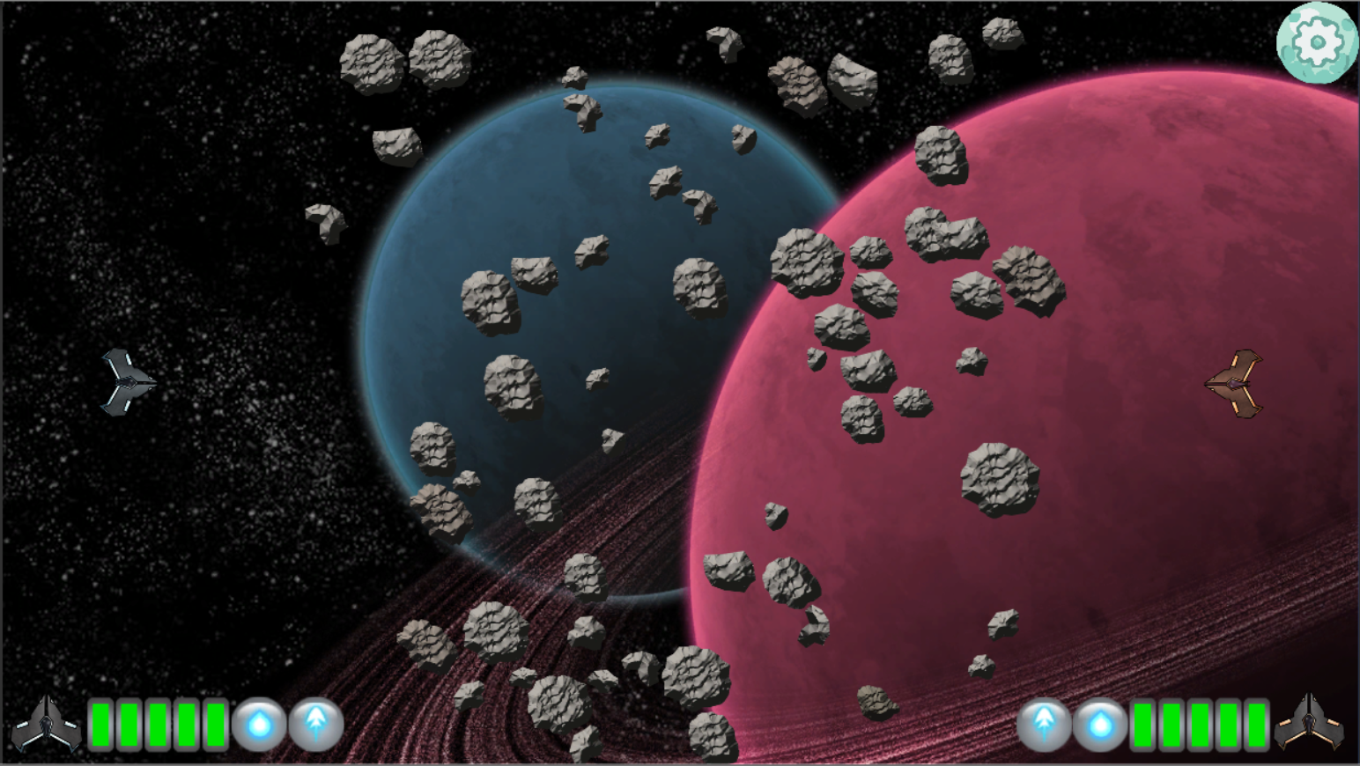
Overview
Platform - PC
Number of players - 2
Duration of play - 3-5 minutes

Slide 5

How our game meets the brief
The player must precisely shoot their missiles into the asteroids in order to receive the desired trajectory
Both players have the same tools available to them
The rules are simple, fire missiles into asteroids to injure the opposing player
We can justify our theme via the results of our research
Notes:
Both players use the same tools making it symmetric

Slide 6
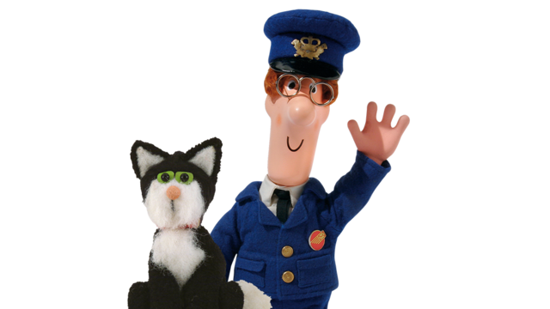

What we will deliver in the final week
Fully operating UI and menu system
Further playtesting
Two person combat
Estimated productivity: 30 hours of work

Slide 7
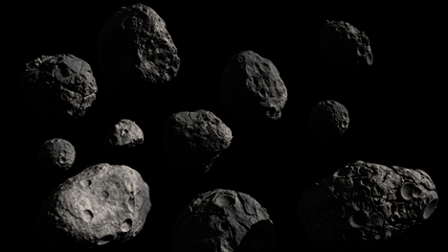
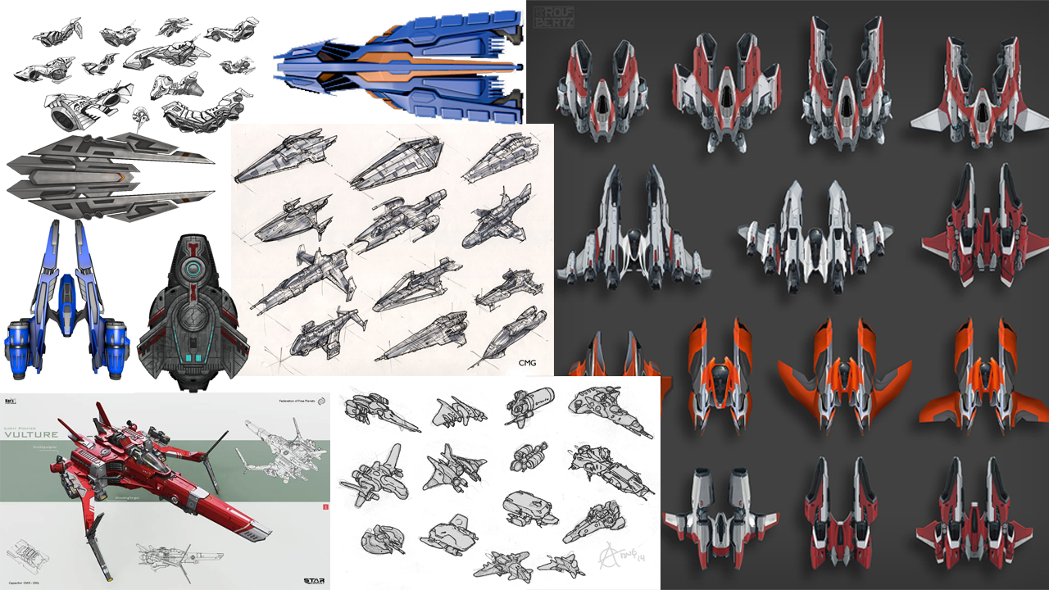
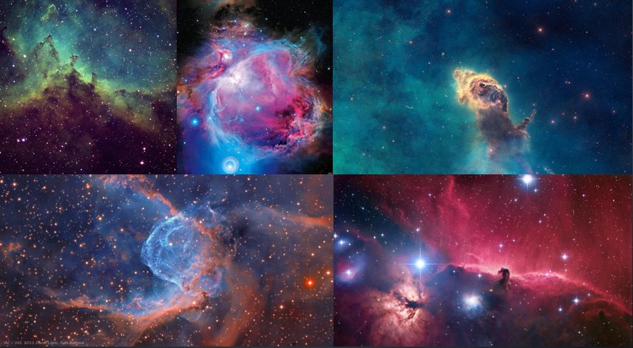
Research

Slide 8

Mechanics
Players have 2 types of rocket:
Blast rocket : simply alters the position of asteroids
Fragment rocket: fragments the asteroids into 4 shards with a high velocity and low mass
An unstable black hole is active in the area, appearing for a short time to disrupt the play area
Notes:
The aim of the game is for players to shoot rockets at asteroids in order to affect their trajectory and damage their opponent’s ship
The player has to be able to judge angles quickly, and be able to time the release of their rocket in order to get the desired angle of velocity for an asteroid

Slide 9
Gameplay

Slide 10

Playtesting Feedback
The difference in backgrounds and the asteroids gives the game a really nice 2.5D feel
Change the projectiles so that there is a clear difference between them
The boundaries on the play area sometimes felt like they got in the way
The period of invincibility after being injured was unclear and made playtesters feel as if some asteroids caused no damage

Slide 11
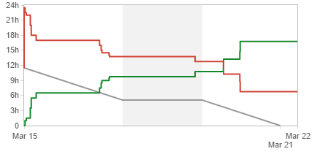
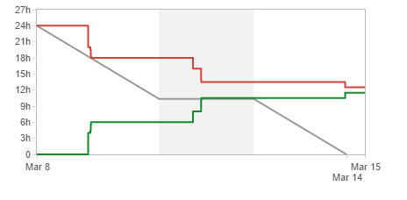
Management
Hours:-
Oliver: 61
Thomas: 28
Amy: 50
George: 29
Total: 168
Notes:
As of W/C 22/03 (hours for this week as yet uncounted)

Slide 12
Questions?

